Slide 1
DESIGN PORTFOLIO
BY NATALIA SOBON

Slide 2
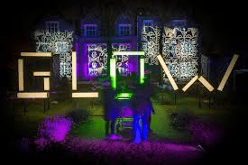
Live Brief: Optical Illusion and Light Project: ‘Glow Festival’:
The whole aim of this project was about being creative and creating a illusion that captures the heart of light. Also bringing light to the dark months and opportunity
for whole communities and bring them together to celebrate . The main theme of the the project was ILLUSION : exploring perception, magic , perspective and so much more .

Slide 3
Live Brief: Optical Illusion and Light Project: ‘Glow Festival’:
Sketches :
So for this project i have designed this ‘Lighted Up Bridge’ that has bulbs builded in that light up at night , this is all by using the solar panel that would be placed at the top , this “Bridge” is perfect to sit under it and just chill not mentioning that is great to take pictures with it at night

Slide 4
MODEL IDEAS

Slide 5
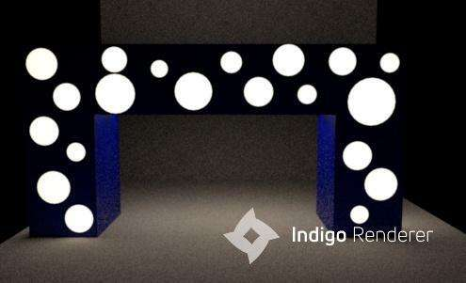
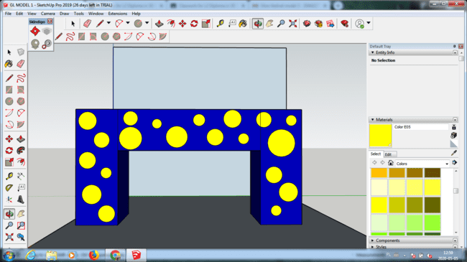
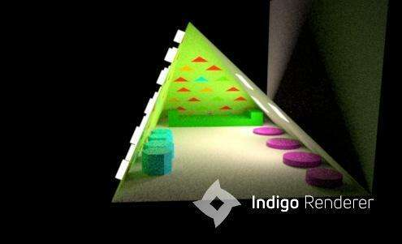
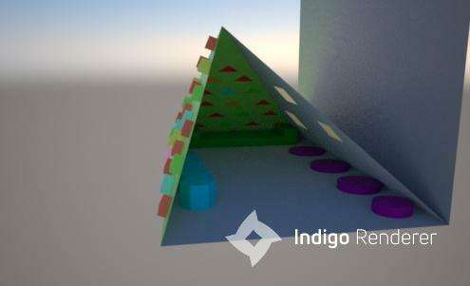
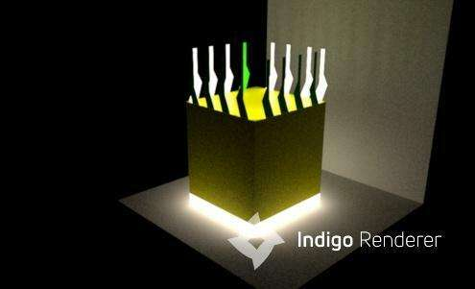
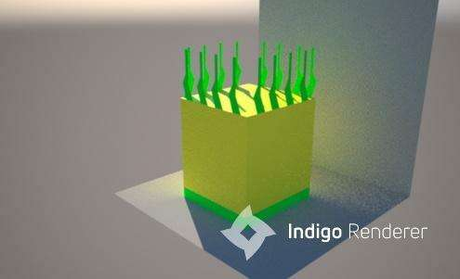
Sketchups

Slide 6
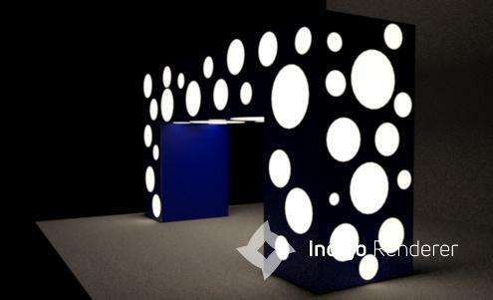
FINAL Concept

Slide 7
POPAI COMPETITION

Slide 8
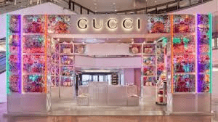
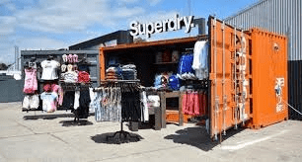
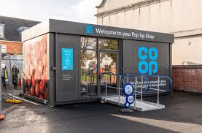
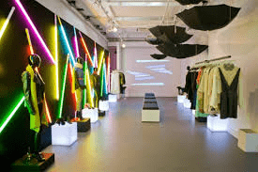
POPAI COMPETITION
The whole aim of this project was to design a “WOW” display or pop up store to promote a product from these any categories -Grocery , Consumer Electronics , Toys, Footwear, Cosmetics. We had to consider many criteria like who is the shopper and so on

Slide 9
Sketches

Slide 10
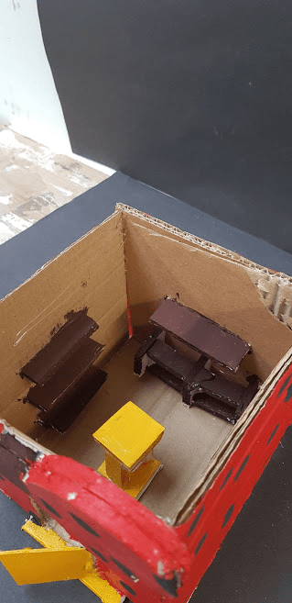
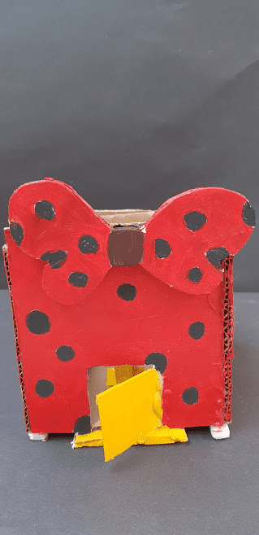
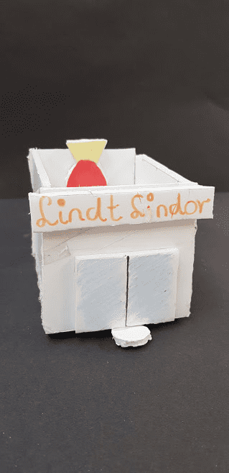
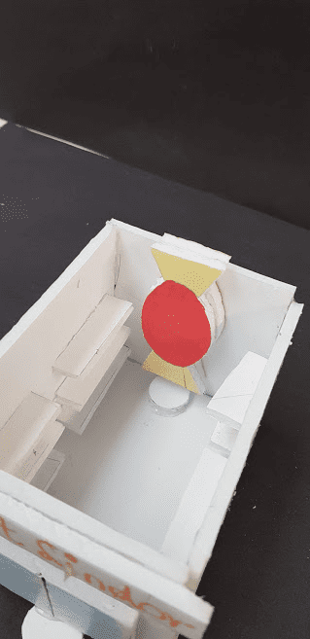
MODELS

Slide 11
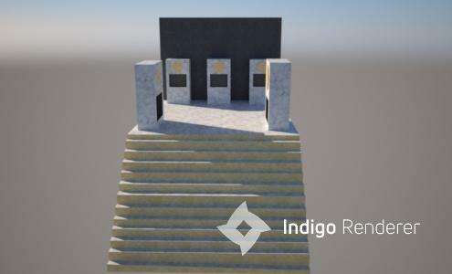
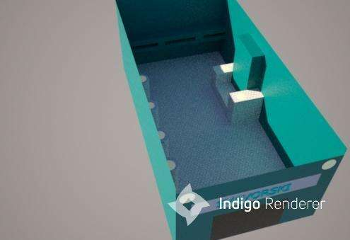
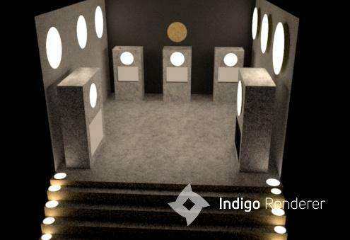
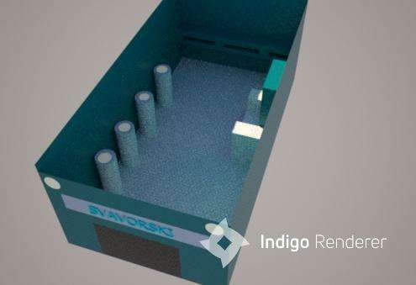
SKETCHUPS

Slide 12
Final Concept

Slide 13
DESKTOP ACCESSORY

Slide 14
Sketches

Slide 15
Final Concept
Sketchup
1:1 scale drawing

Slide 16
Contextual Study

Slide 17
Research
Abstract
Movement
POST
IMPRESSIONISM
POP ART
ART AND CRAFT MOVEMENT
Realism
Movement

Slide 18
Final Outcomes
From the 5 art movements we have chosen to work on we had to use each one movement to come up with of own piece of art .

