Slide 1
Design Portfolio
Connor Bennett

Slide 2
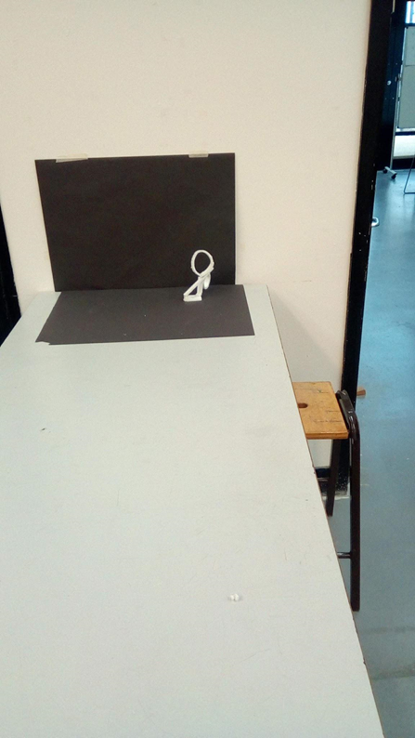
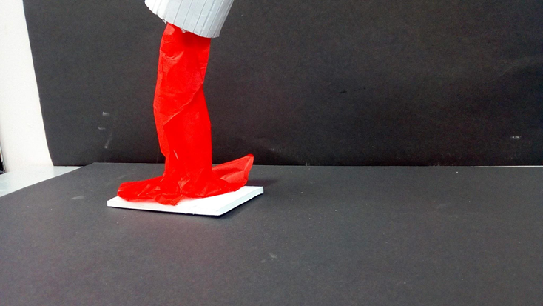
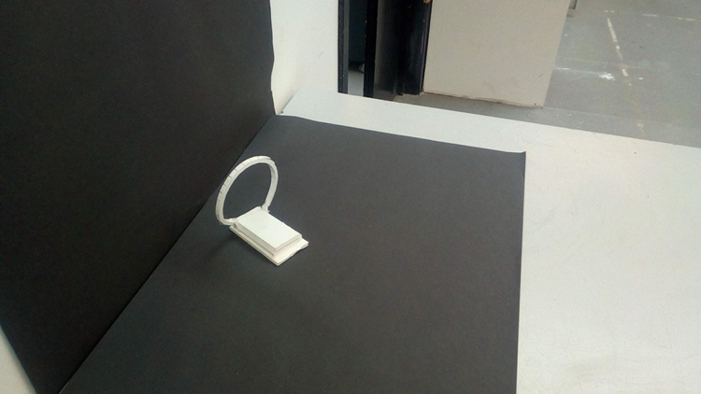
Models
Models are made out of foam board and tissue paper.
Paint pot: this optical illusion is meant to look like a paint pouring out of a can
Portal hoops. These are hoops of light to make it look like a portal

Slide 3
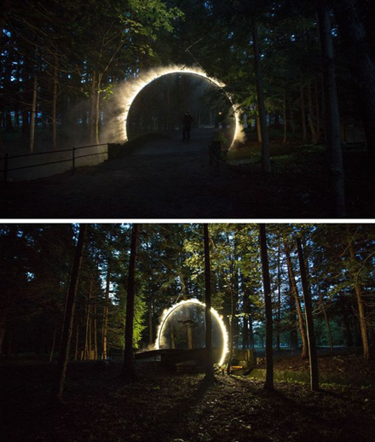
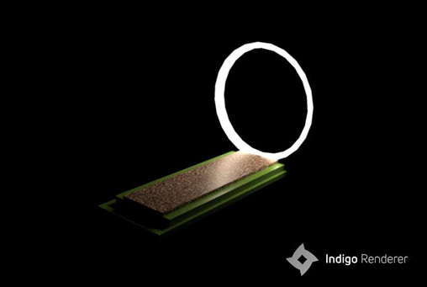
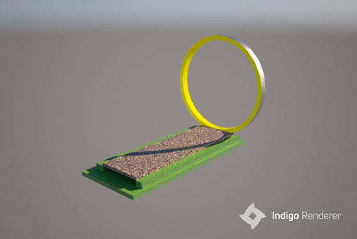
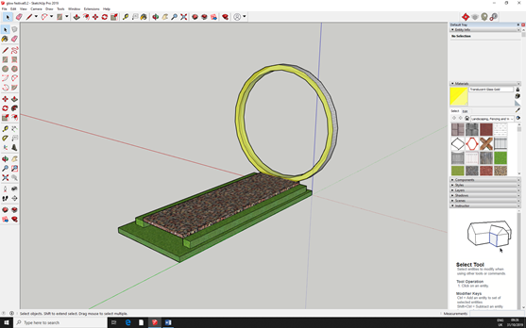
Sketchup design for portal effect
The portal effect is when in fog a ring of light would appear to be diffusing into that fog causing the “portal effect” the idea came from an image that i found where loads of smaller versions of these rings in a forest. And also the other image

Slide 4
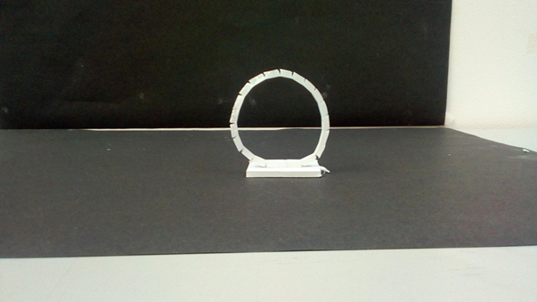
Final Model

Slide 5
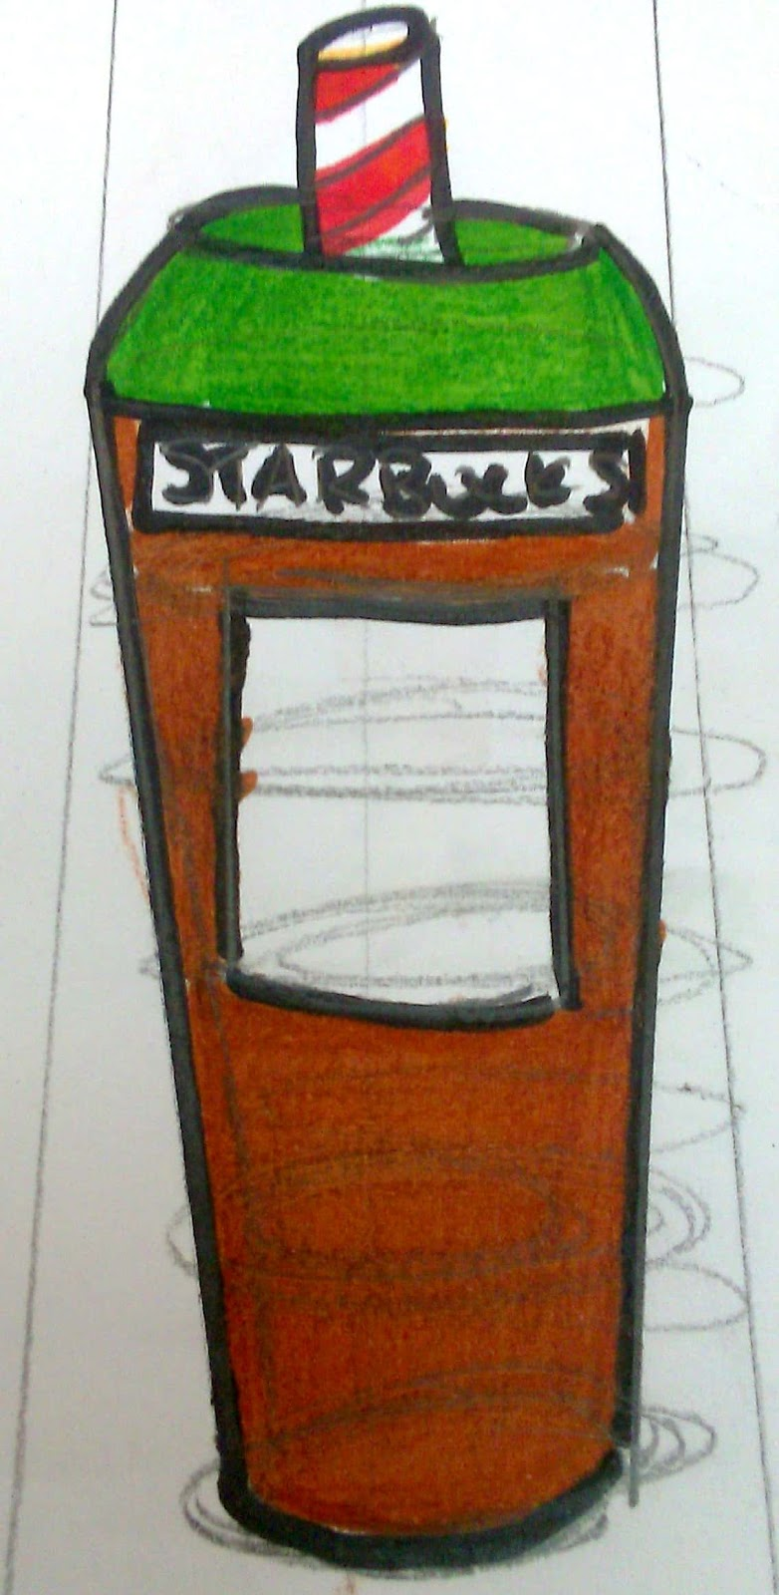
Concept ideas
Designed for a shop display and pop up shop
Designed to resemble a coffee bean because every coffee lover loves where the caffeine shot comes from
Designed to look like a Frappuccino cup to entice coffee lovers to buy a product or drink

Slide 6
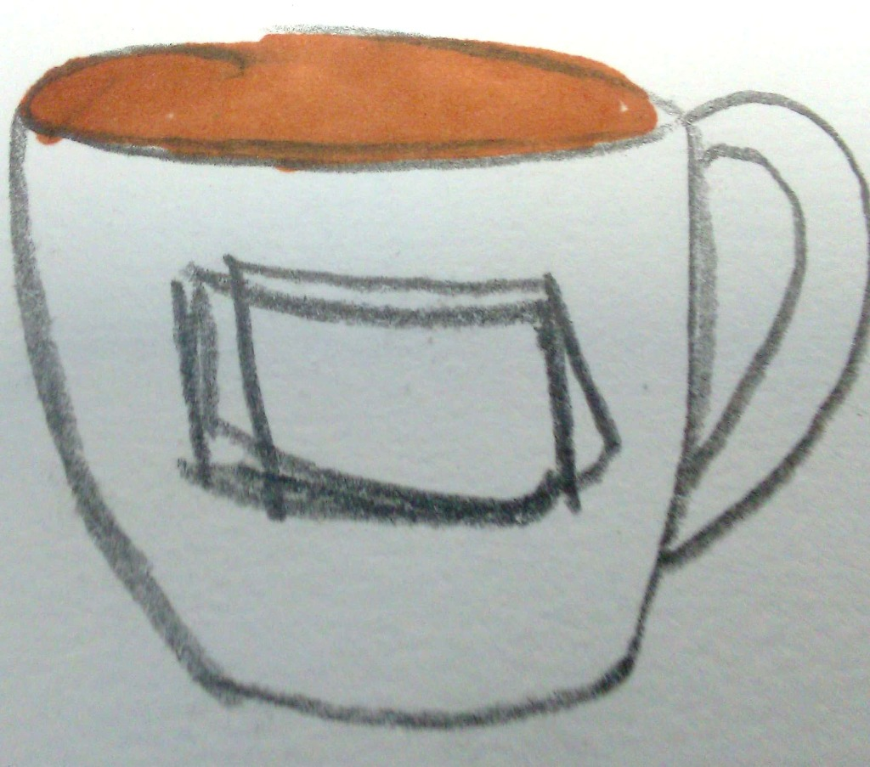
Models
Models made from blue foam and a Dall rod these models are made to look like a coffee mug and a plastic coffee cup

Slide 7
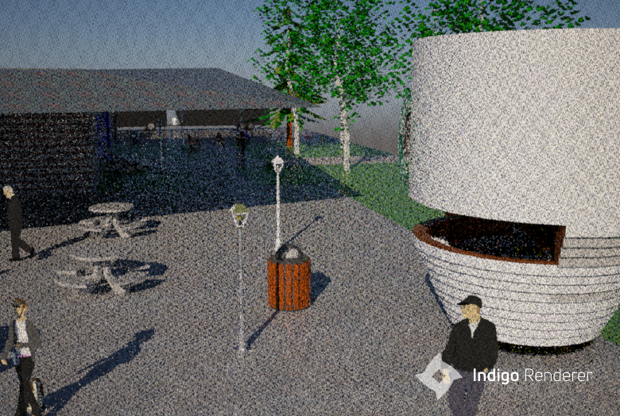
Sketchup
Inspired by the look of modern day pop up bars and coffee cups that Starbucks use this pop up will serve the famous Chicago style coffee that Starbucks have become famous with making.
Made from cost effective non costly Plywood and aluminium body with Dark Oak and aluminium counter top and back wall combined to make a homely feel. Acrylic light covers that diffuse the lights to make it more calming to the customer can be bought in bulk. Shaped as a coffee cup to make it stand out in the row of other coffee shops.
Designed to attract, wonder and captivate. This design is directed towards the everyday coffee lover. This is targeted more towards teenagers and adults and will be equipped with the normal Starbucks coffee makers and cups.

Slide 8
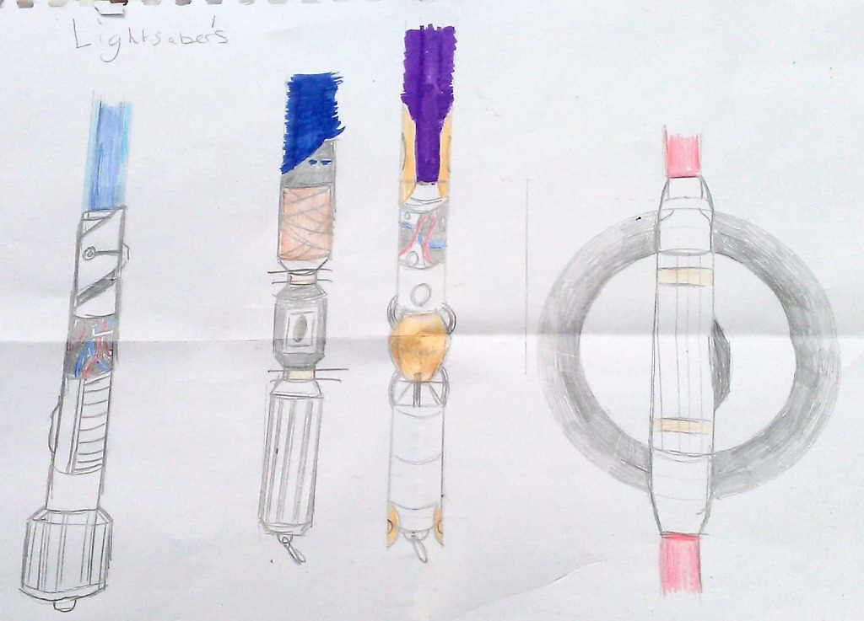
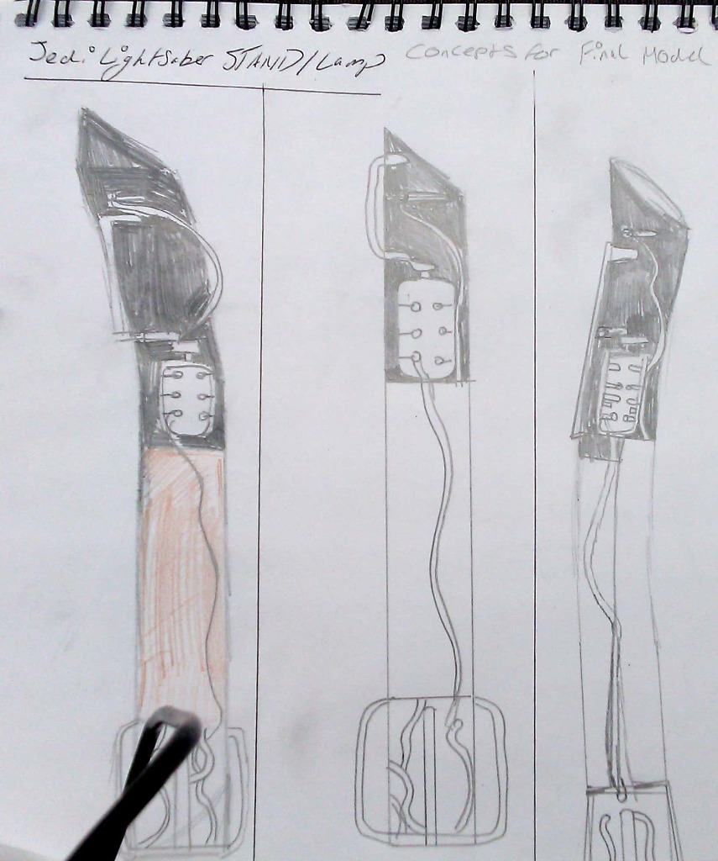
Concept art
Desk lights designed to look like Lightsabres. These will have dual purpose as a toy and also a light.

Slide 9
Models
The Ancient One
Inspired by the old republic lightsabres from the old republic game this model uses blue foam and paint to represent the materials that will be used
The peace Keeper
Inspired by the fallen order game and also lightsabres sold at Disney's galaxies edge. The orb in the middle represents the chamber holding the kyber crystal
The Reaper
Inspired by a mixture of Luke's and kylo ren's lightsabre this lightsabre represents power and ambition.

Slide 10
Fusion 360

